Slide 1
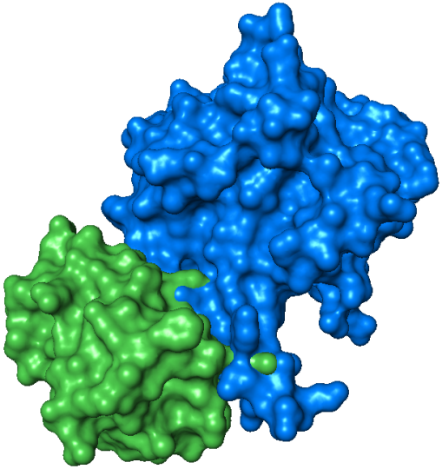
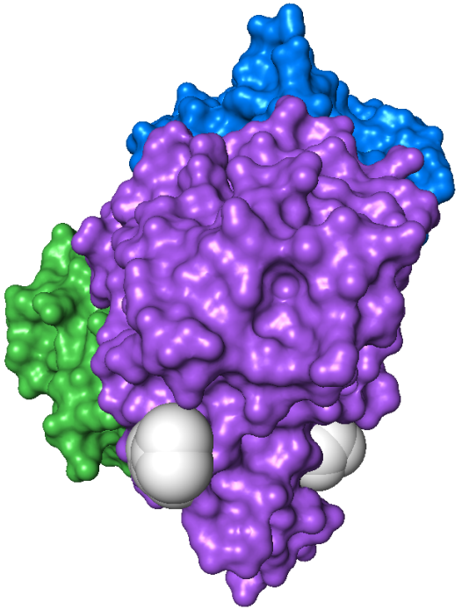
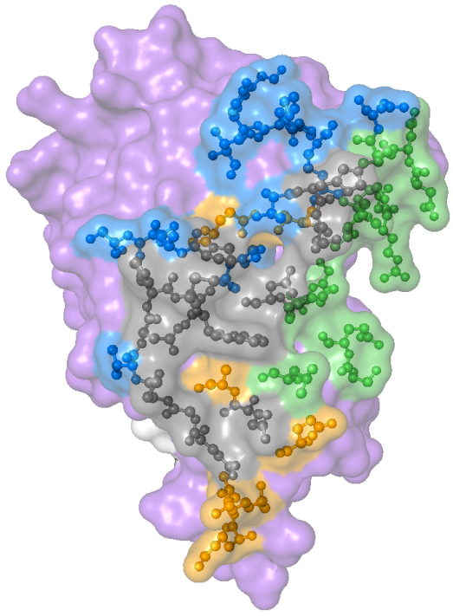
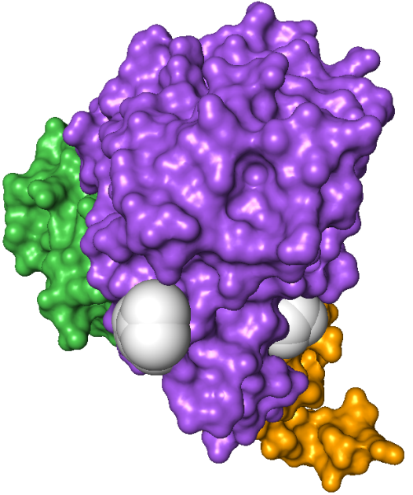
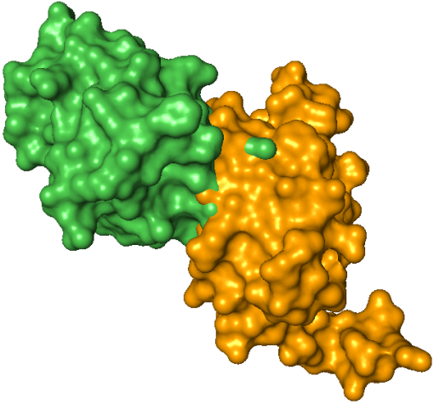
A
NanE
C
Binding sites on
NagB
NanE
HPr
HPr
NagB
M223
D165
NagB
N221
W224
HPr - NagB can only bind
NanE or U-PII
W224
N
C
Inter-subunit
contacts
B
Inter-trimer
contacts
D
HPr
Interface shared by NanE and U-PII
Quaternary structure of NagB:
NagB
x3
x2
HPr
U-PII
Hpr, NanE, U-PII combined interface

